Slide 1

Final Project
By Ann Phan, Sabarish Mogallapalli, Jerry Zhong, Mohammed Raheem

Slide 2

Introduction
We used the Video Game dataset
Primary Research Question: Build a predictive model that will effectively predict the release rating for new datasets.
Secondary Research Question: Build a model that will yield reliable interpretative insights about relationships between variables

Slide 3

1) Motivation
Motivation: Useful for game developers to determine whether their game will get the rating they need to succeed
Features.Max Players: Target audience
Metrics.Review Score: Game's quality and content
Metrics.Sales: Game's popularity and appeal
Metrics.Used Price: Longevity and replayability
Release.Console: Different platforms cater to different audiences with own rating standards
Release.Rating: Rating given to the video game (E, M, T)

Slide 4

2) Dataset discussion
video_games.csv
1212 observations
There is a variety of categorical and numerical variables (36 in total)
Check data types
No NaN value

Slide 5
3) Dataset cleaning
Create a new dataframe using df.copy()
Changes made to the subset will not affect the original DataFrame
Independent variables: Features.Max Players, Metrics.Review Score, Metrics.Sales, Metrics.Used Price, Release.Console
Dependent variable: Release.Rating(y)

Slide 6

MORE DATA CLEANING
Created a new column 'y' in df_copy based on the replacement of values in the 'Release.Rating' column with 1 for 'E', and 0 for 'M' and 'T'
Dropped outliers – 1067 observations left
145 outliers removed
Changed the variable names to ensure the models work
e.g: 'Metrics.Review Score':'Metrics_Review_Score'

Slide 7
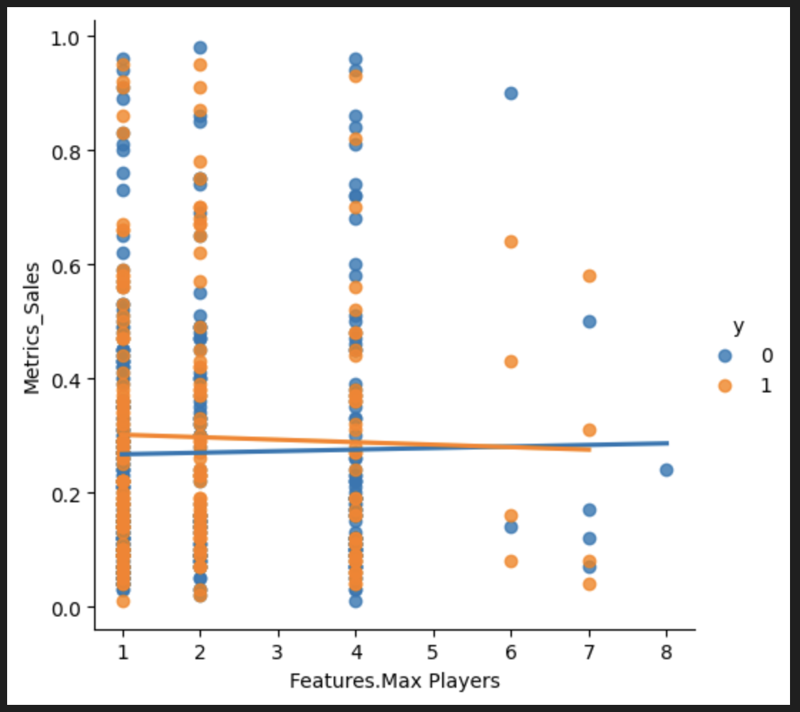
4) PRELIMINARY ANALYSIS
Used lmplot to illustrate correlation between 2 independent variables

Slide 8

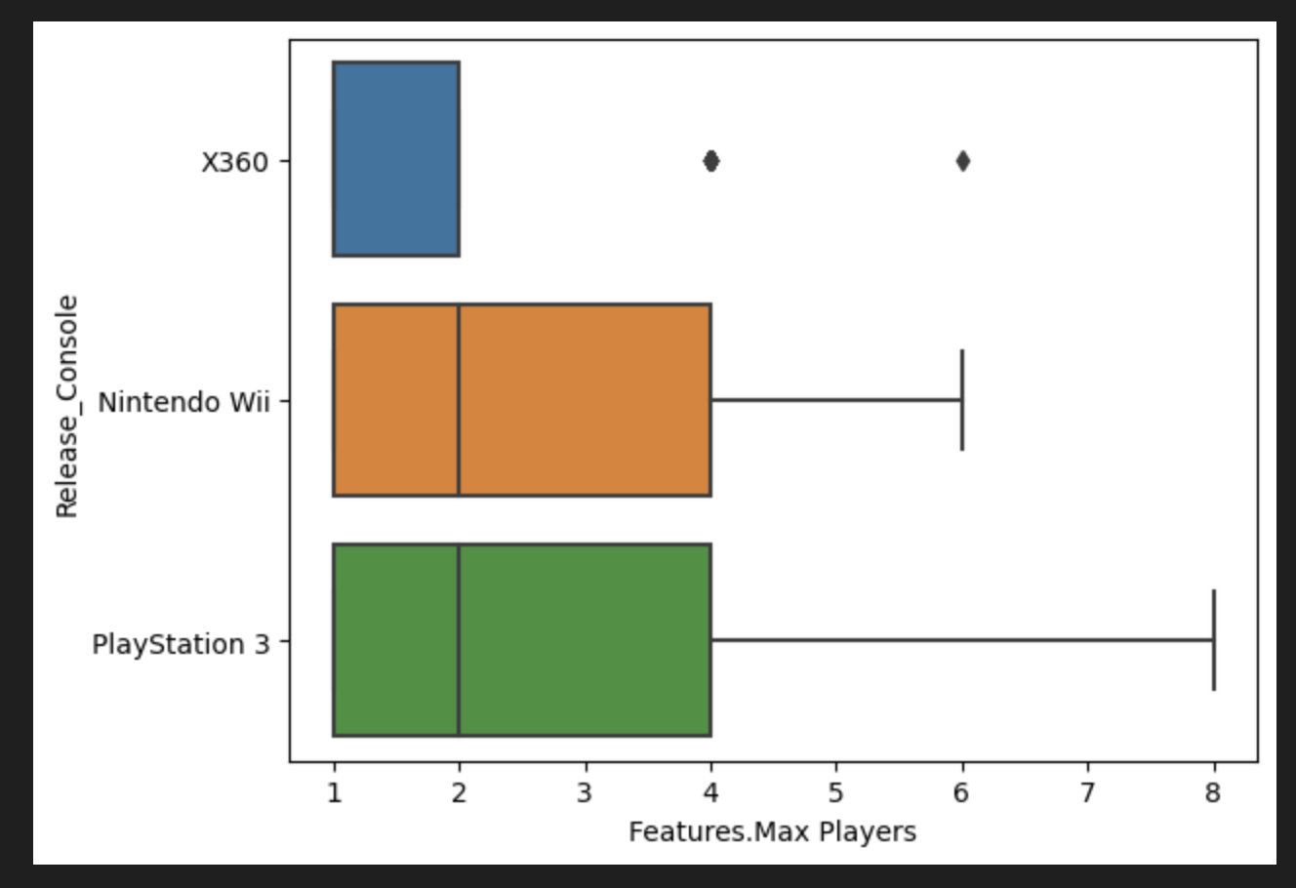
4) PRELIMINARY ANALYSIS
Used boxplots to identify and drop outliers for each independent variable

Slide 9
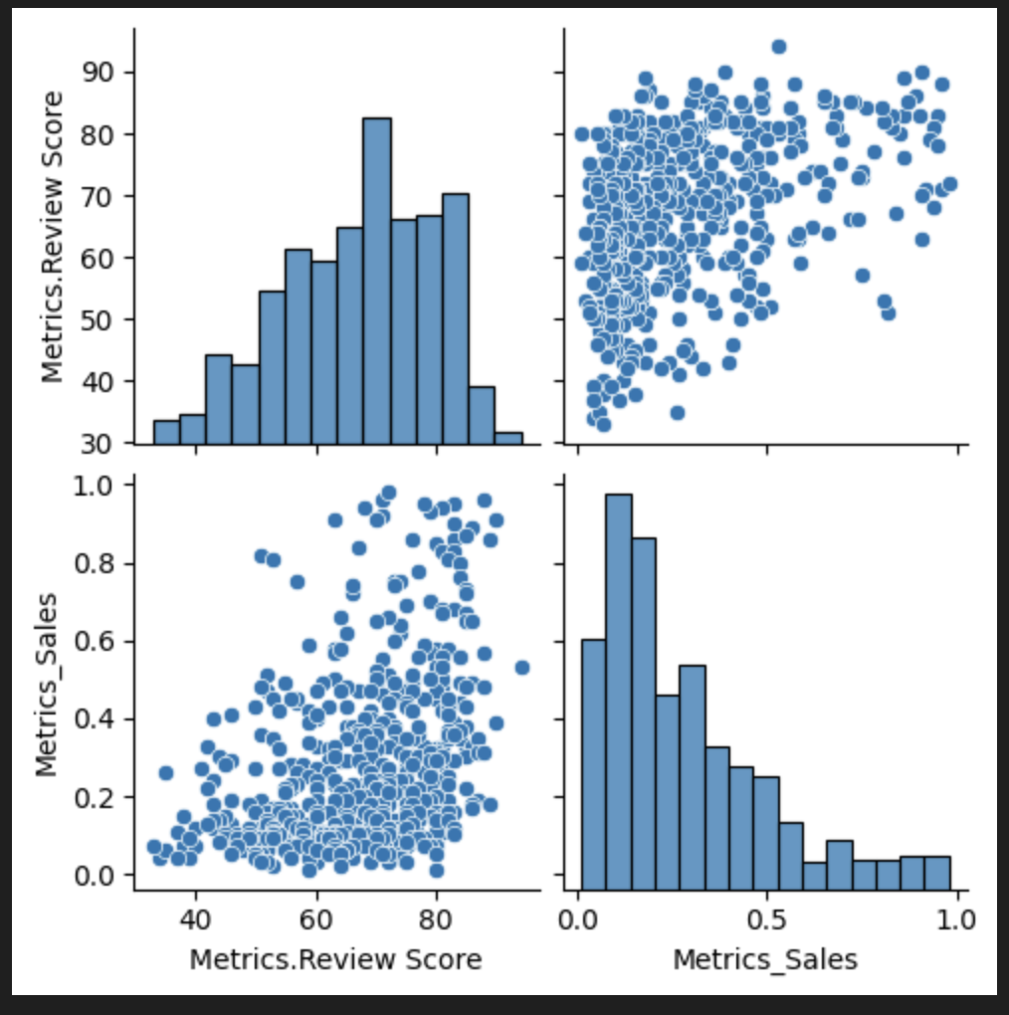
4) PRELIMINARY ANALYSIS
Used pairplots to show correlation between an independent variable and the dependent variable

Slide 10
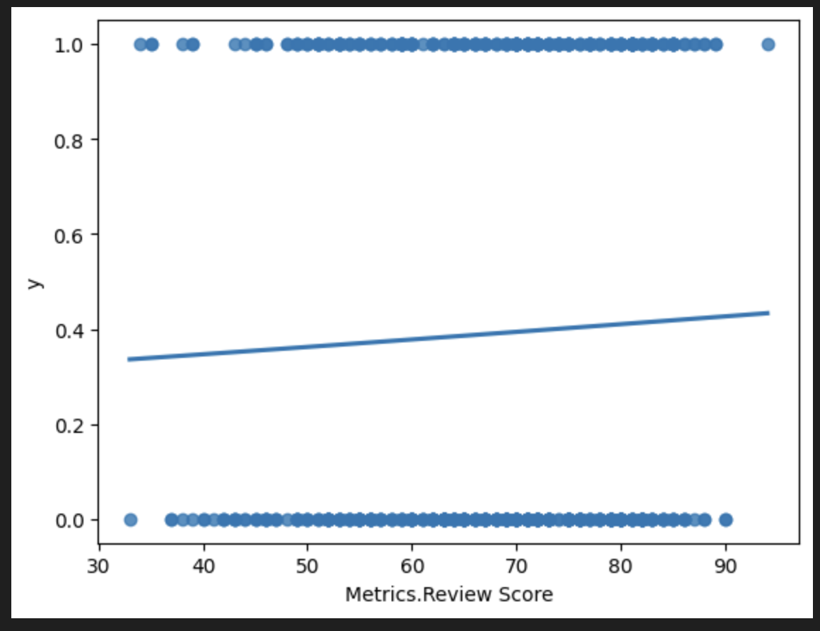
4) PRELIMINARY ANALYSIS
Used regplots to assess relationship between each numerical variable and y

Slide 11
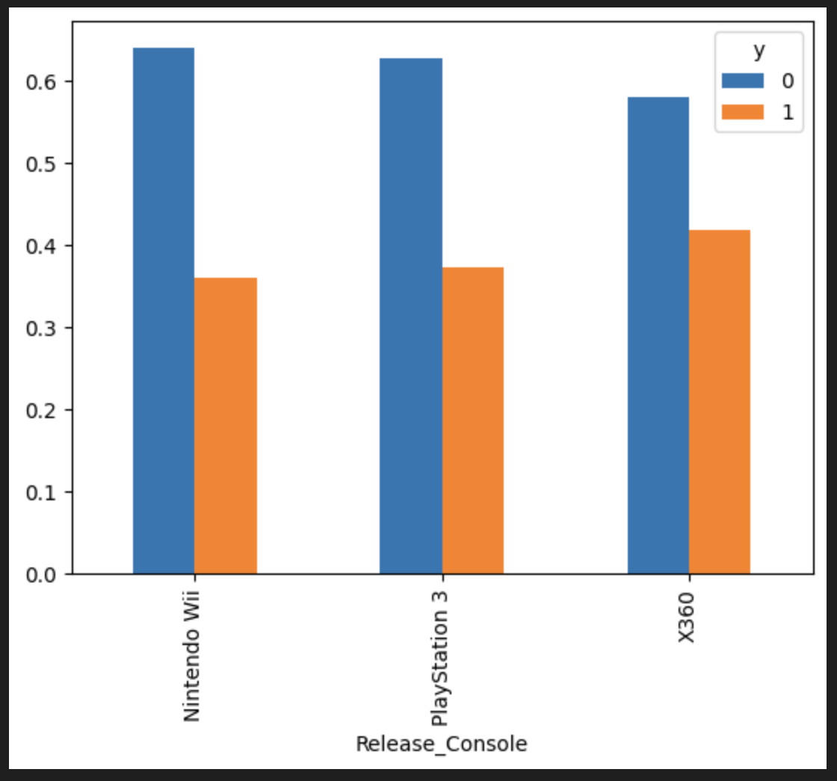
4) PRELIMINARY ANALYSIS
Used barplot to explore relationship between categorical variable and y

Slide 12
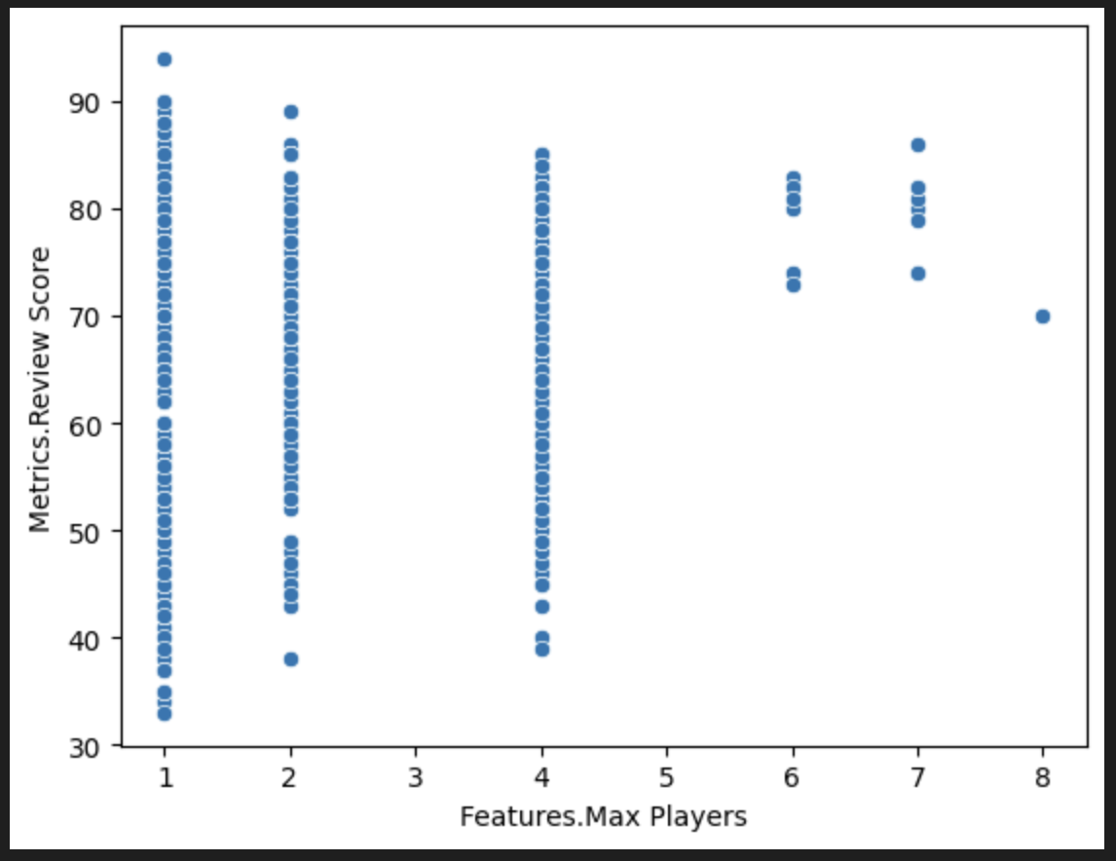
4) PRELIMINARY ANALYSIS
Used scatterplot for each pair of numerical independent variables

Slide 13
5) MODEL DATA PREPROCESSING
Created features matrix and target arrays for both training and test datasets
Scaled explanatory variables
Translated categorical variables into indicator variables

Slide 14
6) FEATURE SELECTION WITH K-FOLD CROSS VALIDATION
Backwards Elimination with K-Fold
Original Model:
y~Features_Max_Players+Metrics_Review_Score+Metrics_Sales+Metrics_Used_Price+Release_Console_Nintendo_Wii+Release_Console_PlayStation_3+Release_Console_X360
Best Model: y~Metrics_Review_Score+Release_Console_Nintendo_Wii+Release_Console_PlayStation_3+Release_Console_X360
Original Model Test AUC (Better but less than 1): 0.5134575569358177
Best Model Test AUC: 0.49706694271911667

Slide 15
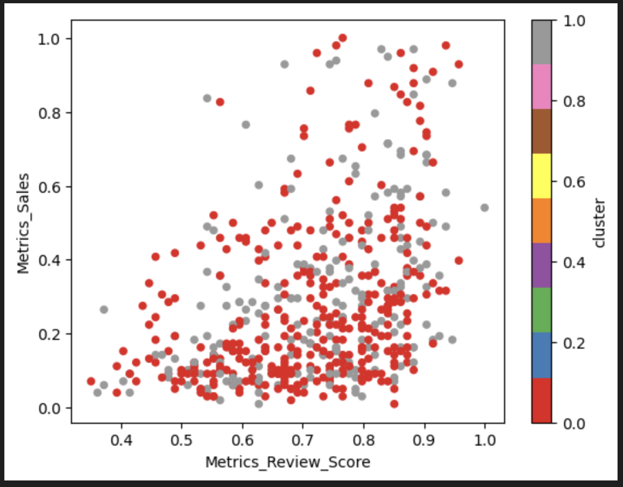
8)Additional Analysis/Insight
Used k_mean to analysis realationship of variables that we use in model.
normalize the data.
Used `kmeans` model and the `numeric_columns`, to predict` the centroid for each row and store that prediction in a new column in `df_copy` called `cluster.

Slide 16
CONCLUSION
Strong Influence of Release Rating: The analysis conclusively showed that Release Rating has a significant influence on various aspects of the dataset. This suggests that Release Rating is a key factor in understanding and predicting the trends and patterns within our data.
Variability in Relationships: The varying strengths of correlations identified through lmplots and pairplots indicate that while Release Rating is influential, its impact is not uniform across all variables. This variability is crucial for tailoring strategies specific to different aspects of the dataset.

Slide 17
Acknowledgement of Limitations: Recognized the limitations of the chosen methods, including the assumptions of K-means and potential impacts of data cleaning and outlier removal processes.
Shortcoming

